Slide 1
MyBank Banking application
Team: Wealth Warriors
Module: Insurance Application

Slide 2
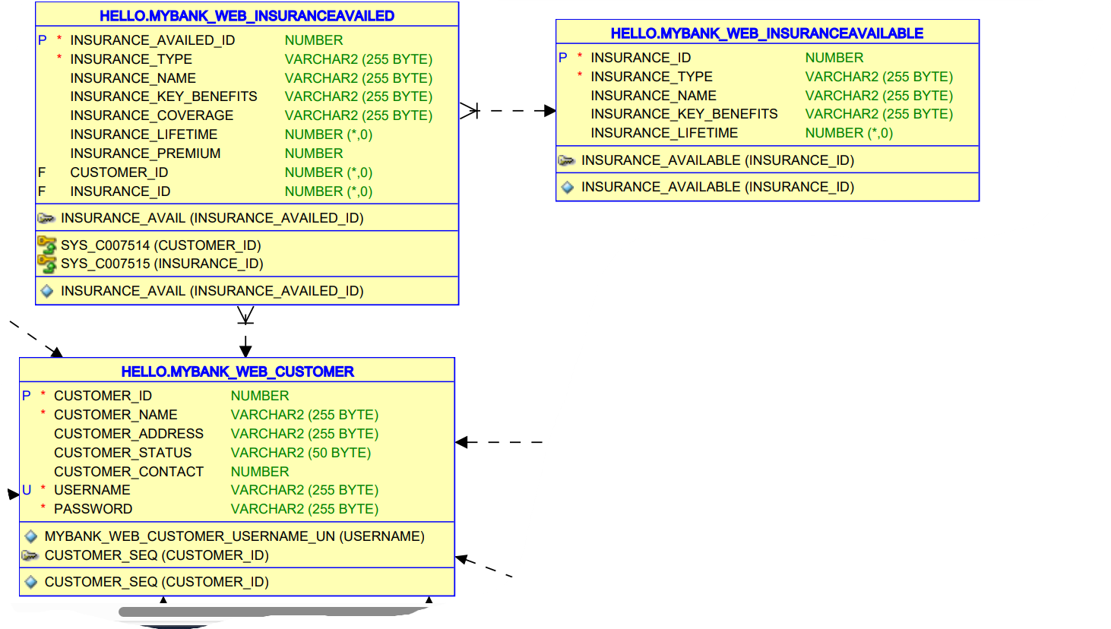
Database design

Slide 3
VIEW INSURANCE MODULE:
Upon the successful login, we provide a menu of insurance types.
View All Insurance type: Displays a list of all insurance types available in the database . It has attributes
INSURANCE_ID
INSURANCE_TYPE
INSURANCE_NAME
INSURANCE_KEY_BENEFITS
INSURANCE_LIFETIME

Slide 4
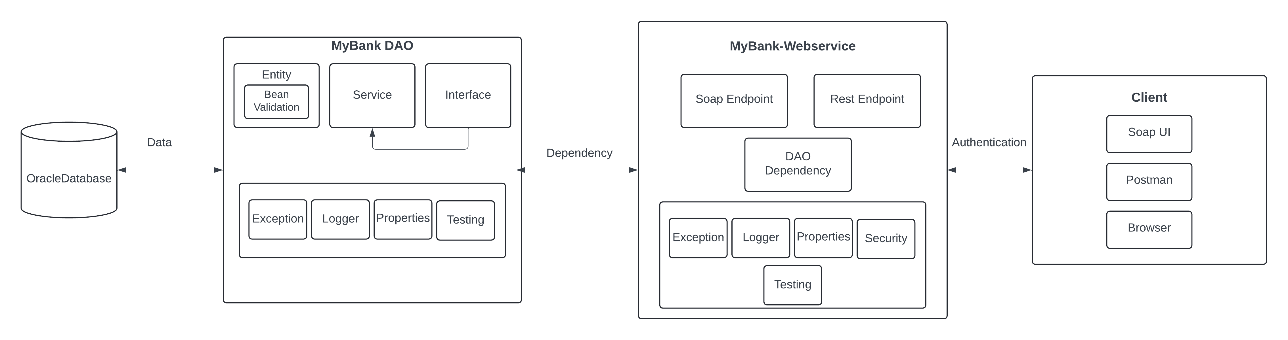
Project Structure:

Slide 5
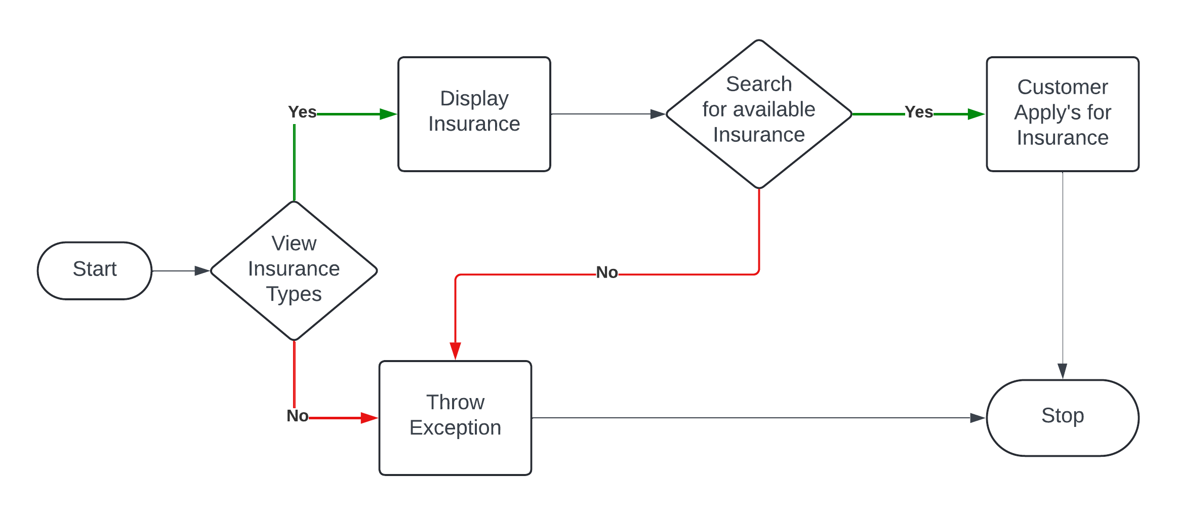
Data Flow Diagram

Slide 6
Links and Files
Git hub link- DLTE-Java-Full-Stack-ElroyMerwynMonis-2024/DLTE-MyBank-Project at master · elroy26/DLTE-Java-Full-Stack-ElroyMerwynMonis-2024 (github.com)
Jar File- DLTE-Java-Full-Stack-ElroyMerwynMonis-2024/DLTE-MyBank-Project/MyBank-Insurance-Dao/target/insurancedao-0.0.1-SNAPSHOT.jar at master · elroy26/DLTE-Java-Full-Stack-ElroyMerwynMonis-2024 (github.com)

Slide 7

Thankyou

